Slide 1
Data Analysis 3 (python)
Matplotlib, figures, subplots, colours, markers and line styles
For any questions reach out to: kim.ta@barclays.com

Slide 2
Contents
Creating subplots (multiple plots in one figure)
Figures
Pairwise
Statistical
Colours, markers and styles

Slide 3
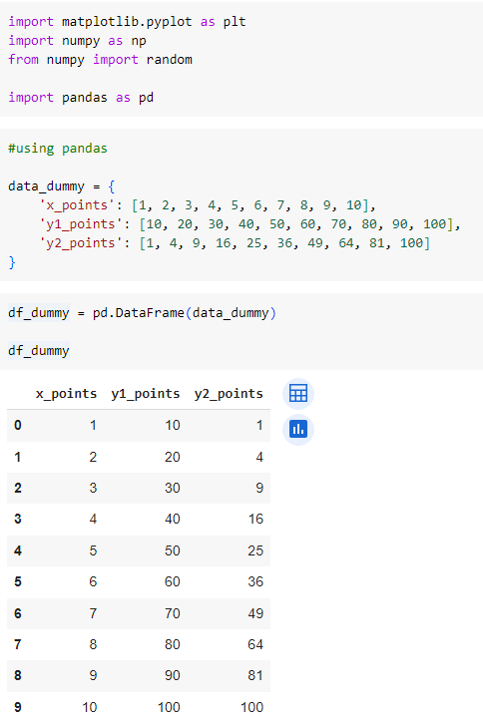
Set-up

Slide 4
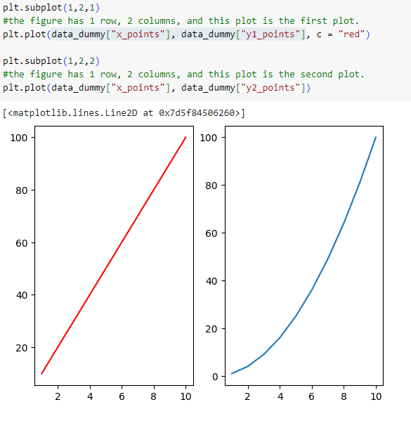
Creating subplots
With the `subplot()` function you can draw multiple plots in one figure

Slide 5
Plots (figures)
plot(x,y) | Line graph: ideal for showing growth rates or trends at even intervals.
scatter(x, y) | Displays relationships between varying variables. It's suitable for displaying associations and correlations.
bar(x, height) | Shows each data category in a frequency distribution. Used to compare things between different groups or to track changes over time.
stem(x,y) | Draws lines perpendicular to a baseline at each location locs from the baseline to heads, and places a marker there. useful tool for visualizing discrete data points and their magnitudes
fill_between(x,y1,y2) | Fill the area between two horizontal curves. This is good for creating confidence intervals. Confidence intervals (CIs) are used in statistics to indicate the range within which we can expect a population parameter (such as a mean or proportion) to lie, with a certain level of confidence.
stairs(values) | Draw a stepwise constant function as a line or a filled plot.
stackplot(x,y) | Used to draw a stacked area plot. It displays the complete data for visualization. It shows each part stacked onto one another and how each part makes the complete figure. It displays various constituents of data and it behaves like a pie chart. It has x-label, y-label, and title in which various parts can be represented by different colors.

Slide 6
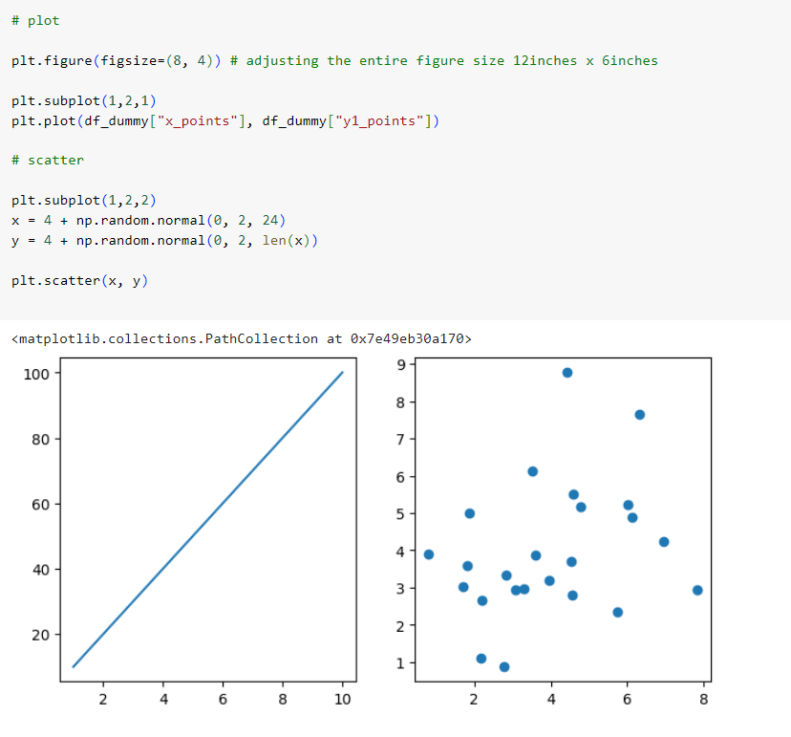
Line graph & Scatter graph
plot(x,y) | Line graph: ideal for showing growth rates or trends at even intervals.
scatter(x, y) | Displays relationships between varying variables. It's suitable for displaying associations and correlations.

Slide 7
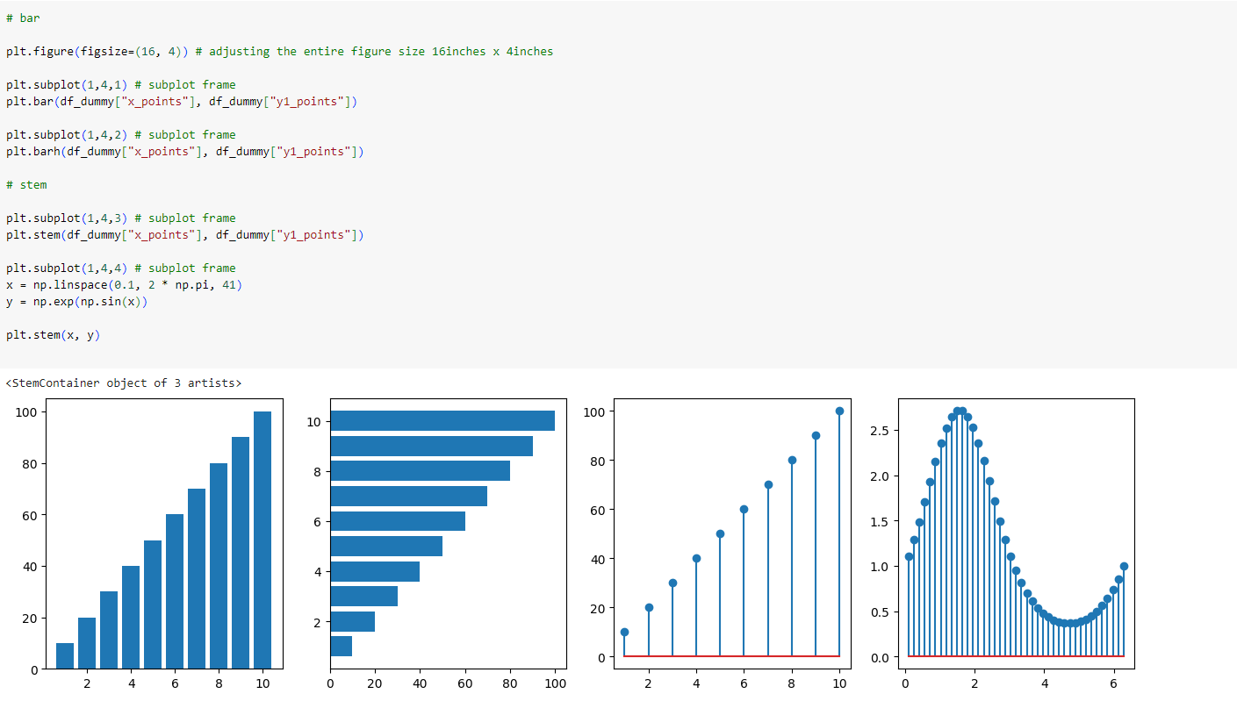
Bar & Stem
bar(x, height) | Shows each data category in a frequency distribution. Used to compare things between different groups or to track changes over time.
stem(x,y) | Draws lines perpendicular to a baseline at each location locs from the baseline to heads, and places a marker there. useful tool for visualizing discrete data points and their magnitudes

Slide 8
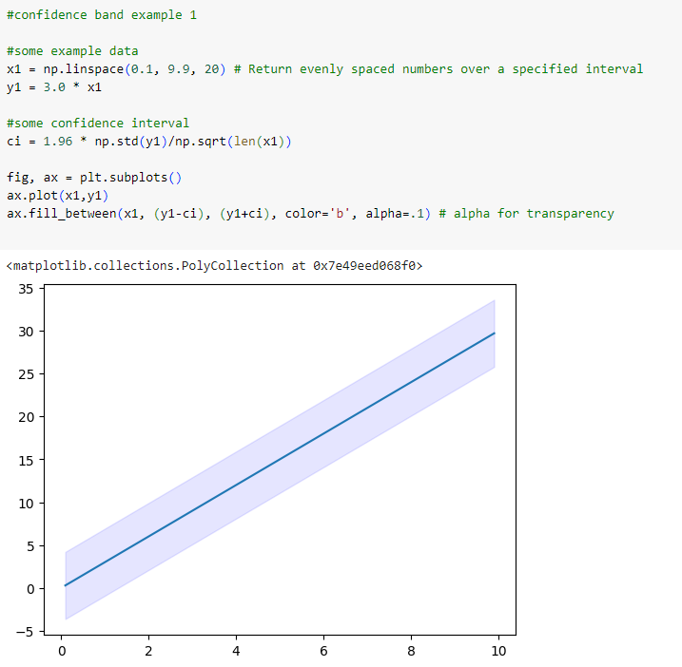
Fill
fill_between(x,y1,y2) | Fill the area between two horizontal curves. This is good for creating confidence intervals. Confidence intervals (CIs) are used in statistics to indicate the range within which we can expect a population parameter (such as a mean or proportion) to lie, with a certain level of confidence.

Slide 9
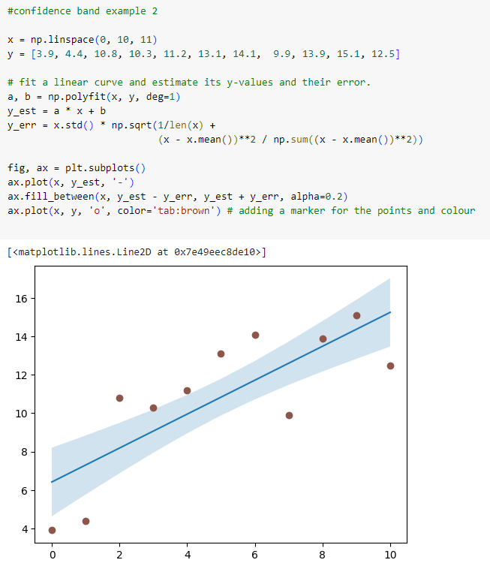

Slide 10
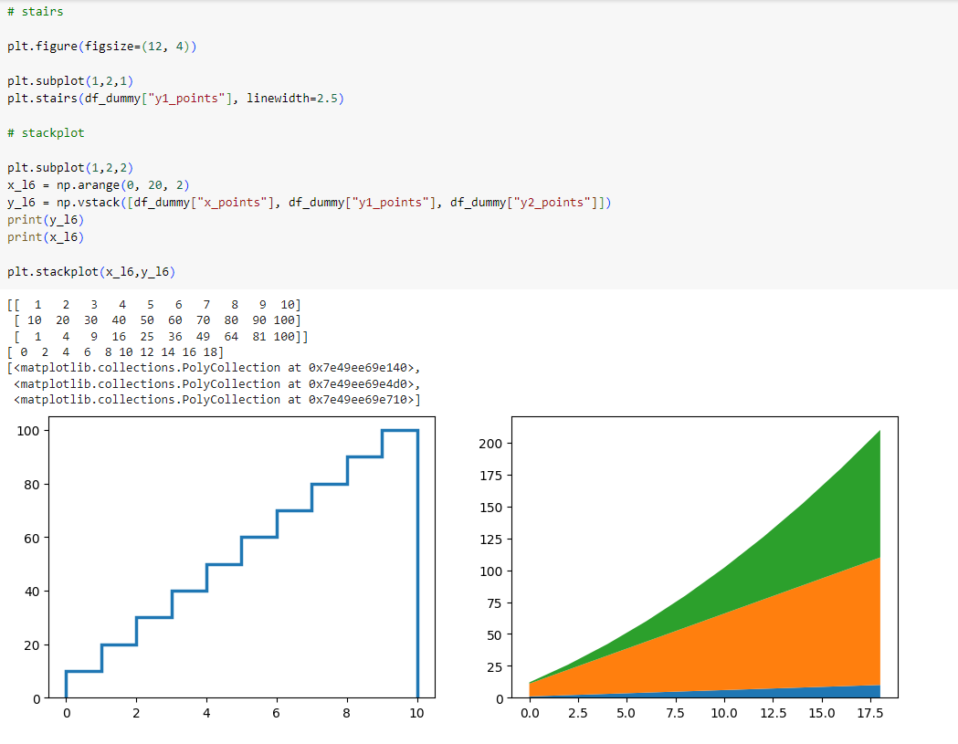
Stack & Stairs

Slide 11
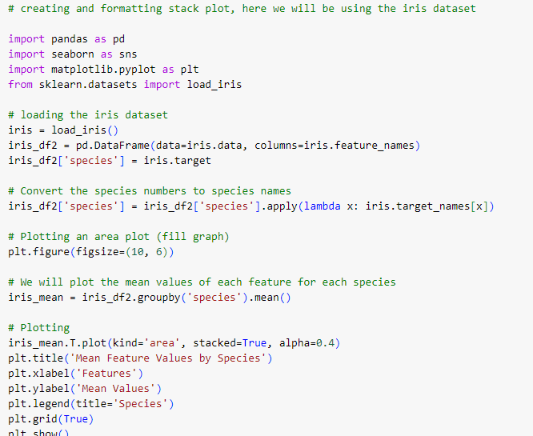
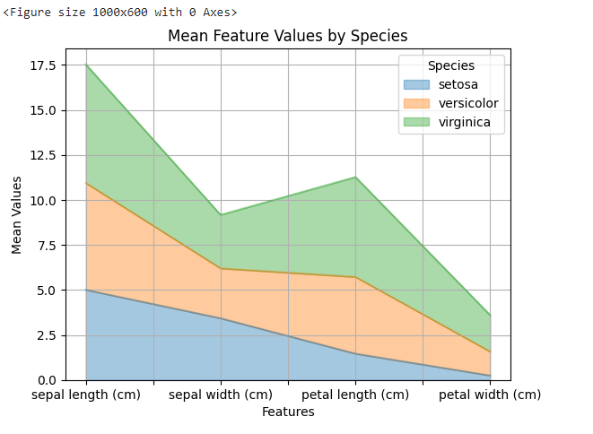

Slide 12
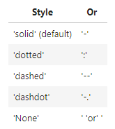
Colours, Markers, and styles
Useful links:
Different types of markers: https://matplotlib.org/stable/api/markers_api.html
Hex colour codes: https://htmlcolorcodes.com/
Line styles: https://developer.mozilla.org/en-US/docs/Web/CSS/line-style

Slide 13
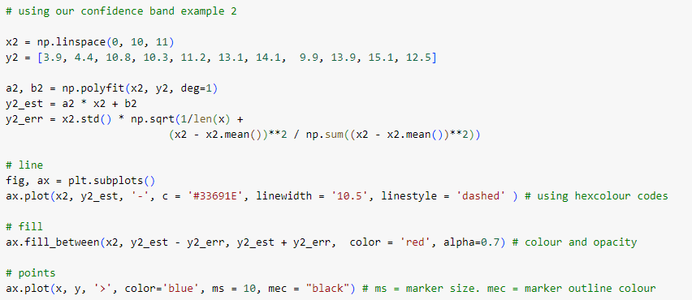
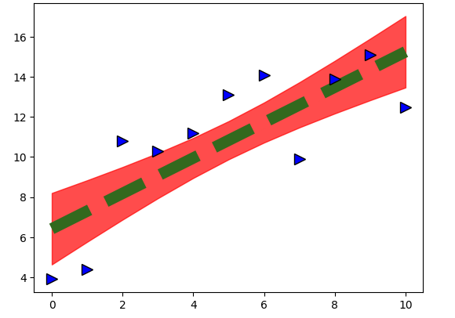

Slide 14
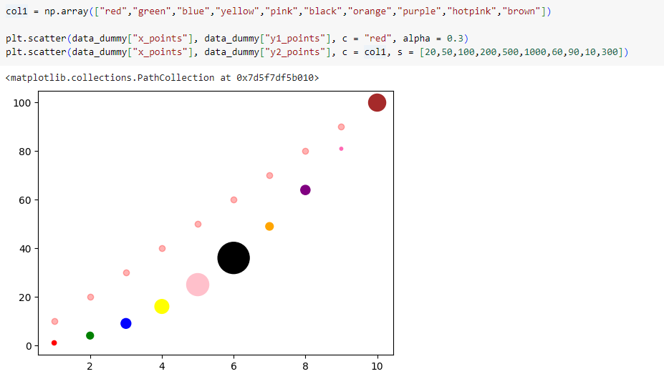

Slide 15
Statistical Distributions
Histograms (1D & 2D)
Box plot
Error Bars
Violin Plot
Event Plot
Hexbin Plot
Pie Chart
Cumulative Distribution Plot

Slide 16
Histogram
A histogram is a graphical representation of the distribution of numerical data. It consists of bars where the height of each bar represents the frequency (or count) of data points within a specific range (bin) of values along the x-axis.
Histograms are used to visualize the distribution of data, showing how data points are distributed across different ranges or bins. They help identify patterns such as skewness, central tendency, and spread in the data.

Slide 17
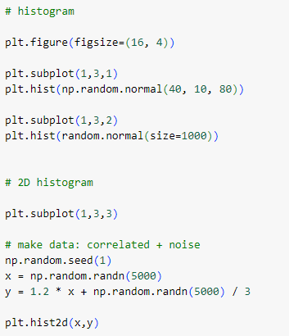
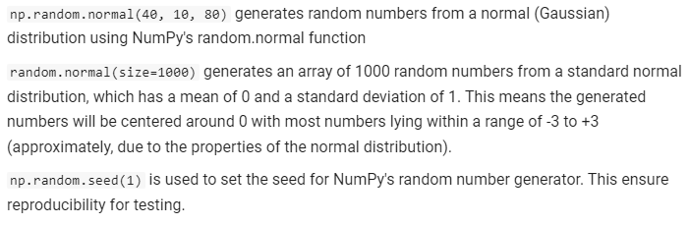
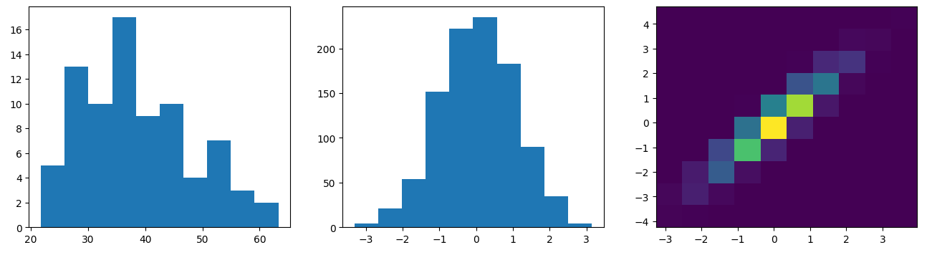

Slide 18
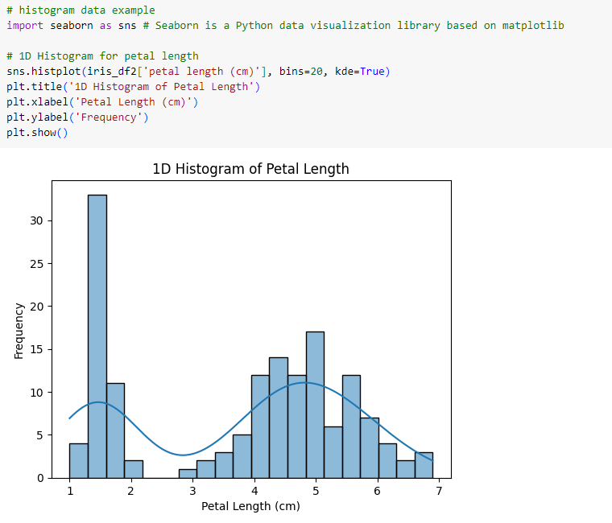

Slide 19
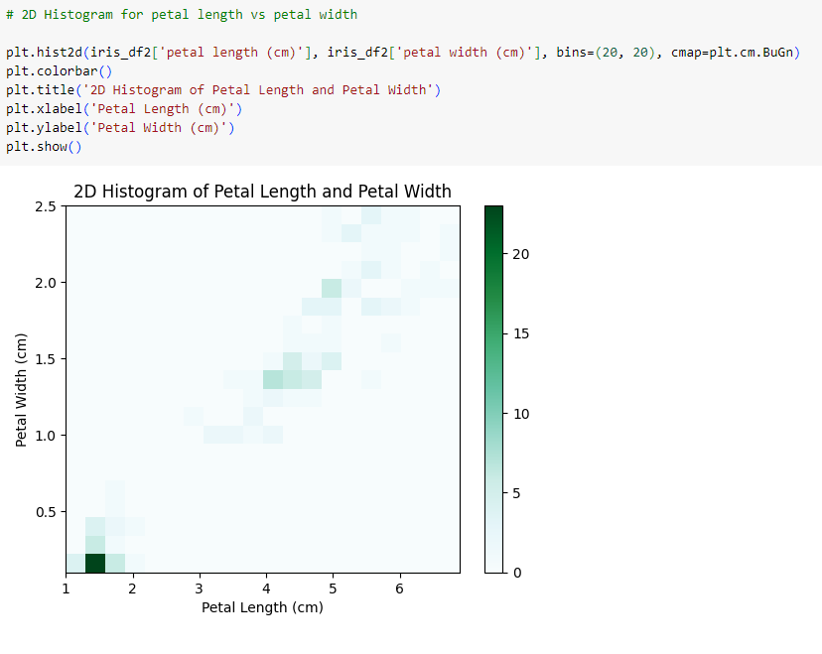

Slide 20
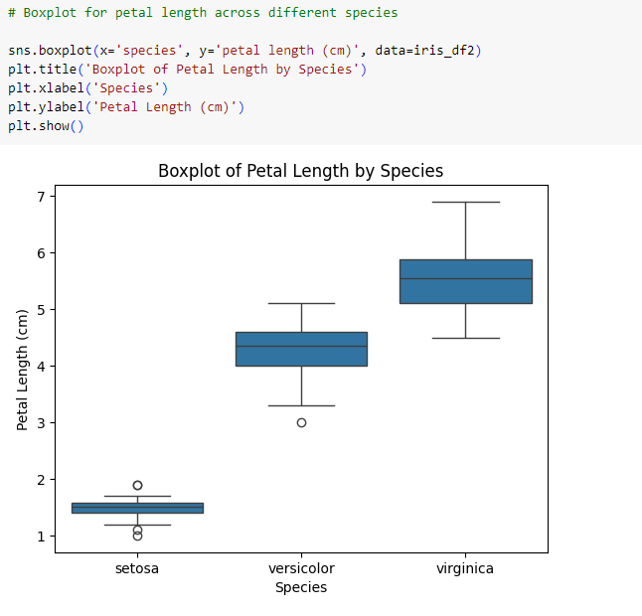
Boxplot
Standardized way of displaying the distribution of data based on a five-number summary: minimum, first quartile (Q1), median (Q2), third quartile (Q3), and maximum. The box represents the interquartile range (IQR) (Q3 - Q1), with the median marked by a line inside the box. Whiskers extend from the box to show the range of the data outside the IQR, and outliers are often displayed individually.
Useful for comparing distributions of data across different groups or variables and for identifying outliers and skewness in the data.

Slide 21
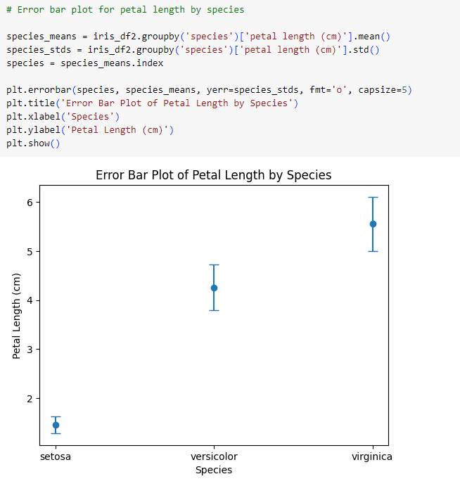
Error Bars
A graphical representation of the variability of data. It usually consists of a line or marker representing the central tendency (mean, median) of the data and bars extending from it that indicate the range of variability (e.g., standard deviation, confidence interval).
Used to visually communicate the uncertainty or variability associated with data points or estimates, especially in scientific and experimental contexts.

Slide 22
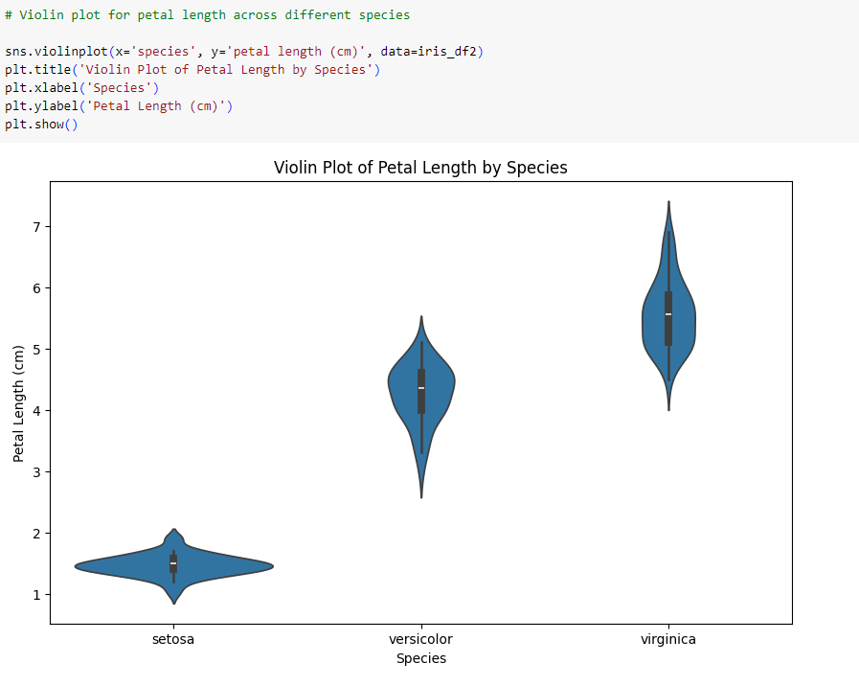
Violin Plot
Is a combination of a boxplot and a kernel density plot. It displays the distribution of data across different levels of one or more categorical variables. The width of the "violin" represents the frequency or density of data points at different values, giving a more detailed view of the distribution compared to a boxplot.
Useful for comparing the distribution of data across different categories or groups, providing insights into both central tendency and variability.

Slide 23
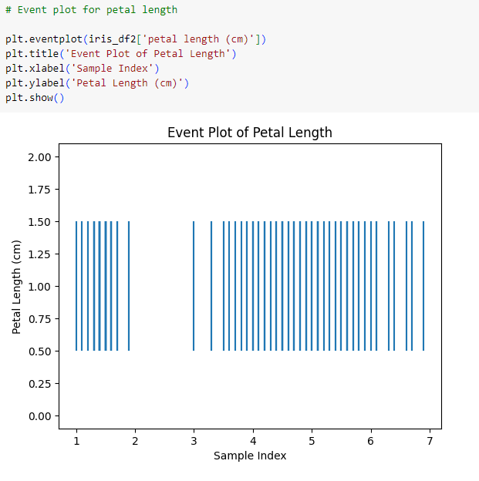
Event Plot
Used to display the occurrence of events (usually points in time) along a single axis, typically the y-axis. Each event is represented as a vertical line or marker at its corresponding position on the axis.
Used to visualize the timing and frequency of events, making them useful in fields such as signal processing, neuroscience, and time-series analysis.

Slide 24
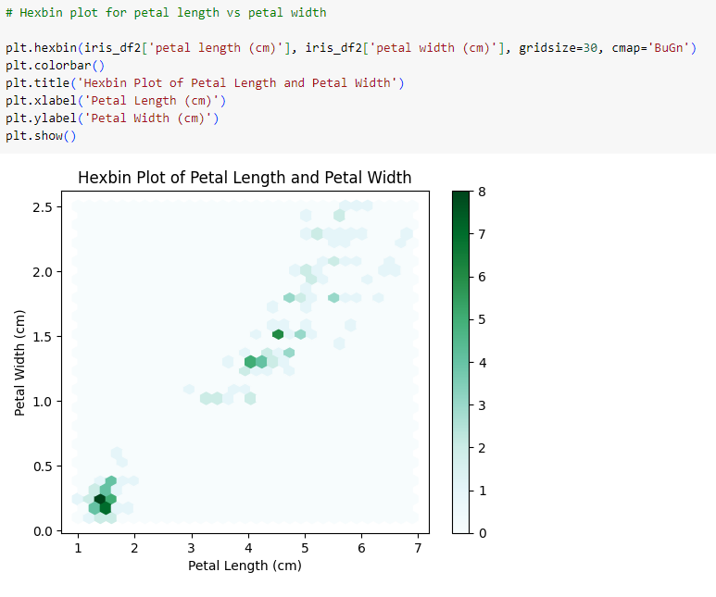
Hexbin Plot
A two-dimensional histogram where the data points are divided into hexagonal bins. The color intensity or density of each hexagon represents the number of data points falling within that bin.
Used to visualize the distribution of data points in a two-dimensional space, especially when dealing with large datasets or when scatter plots become too dense to interpret clearly.

Slide 25
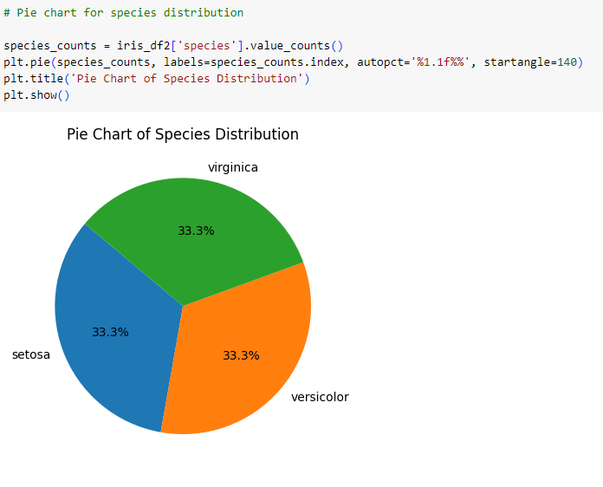
Pie Chart
A circular graph divided into slices, each representing a proportion of a whole. The size of each slice is proportional to the percentage it represents of the total.
Pie charts are used to show the relative contribution of different categories or parts to a whole. They are useful for displaying categorical data and emphasizing the proportions of each category.

Slide 26
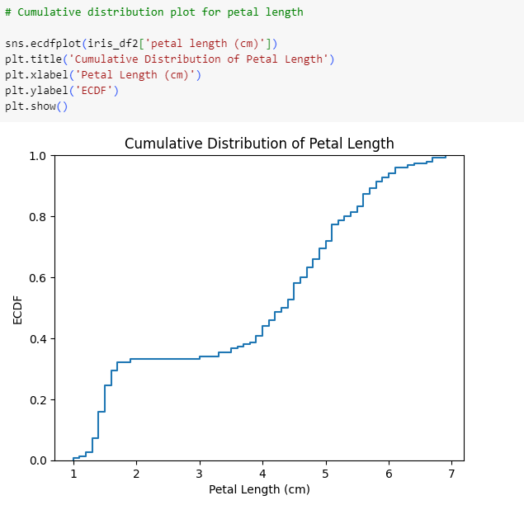
Cumulative Distribution Plot
Used to visualize the distribution of data and to compare the empirical distribution to theoretical distributions.
They provide insights into the distribution's shape, spread, and central tendency.

